Slide 1




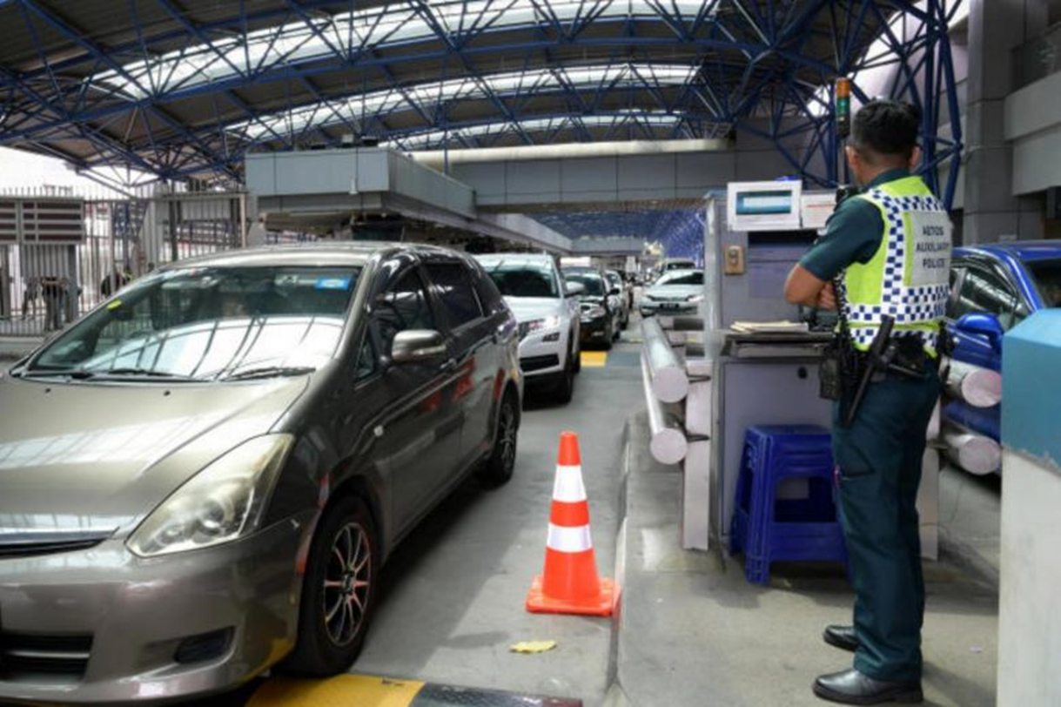
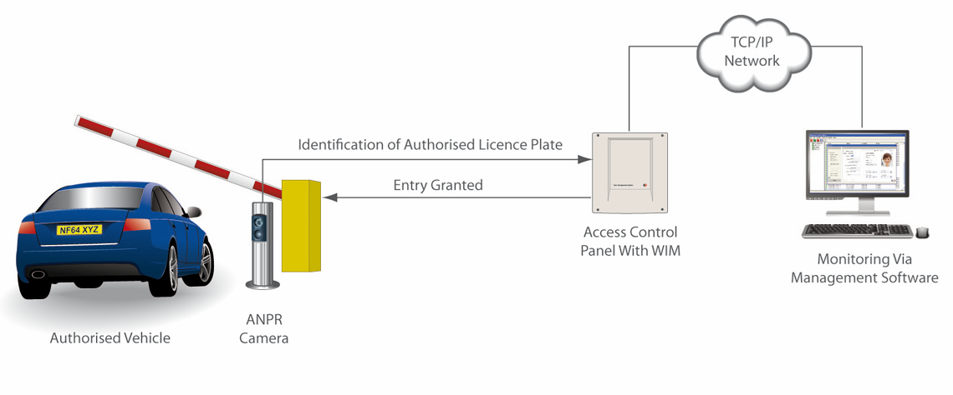
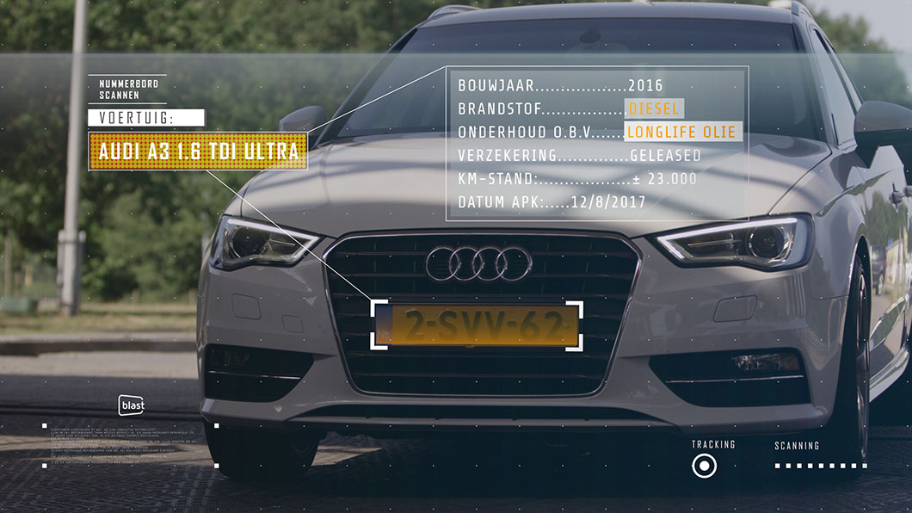
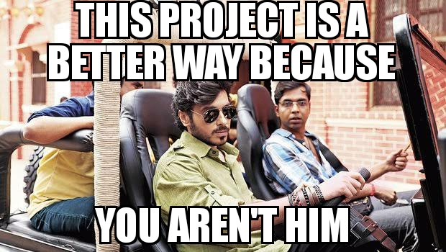
VEHICLE ENTRY & EXIT SYSTEM
First Year Project Poster, Fall 2019, Bennett University, Greater Noida, India
REET AGGARWAL (E19CSE322), RAGHAV GUPTA (E19CSE258), SHASHANK SHEKHAR(E19CSE098), VEDIC PATEL(E19CSE018)
Dept. of Computer Science Engineering, Bennett University, India
Introduction
Tech Utilized
The aim of this project is to make the parking system more efficient.
Problem
Fig. 3.
Tesseract OCR for image to text conversion
The problem with the current manual entry system is that guards take a lot of time to make the entry of vehicle. There’s also no way to track the activities of each and every vehicle in the premises.
Also , sometimes parking space is full but the entry of vehicles is on . This can lead to clumsy situations.
Fig. 4.
Python for file handling and other purposes
User Interface/Demo Snapshots
Fig. 1. Commotion during manual entry
Solution
Our software can ease down the vehicle entry work by entering a vehicle automatically.
Also , a limited time duration can be set after which the vehicle will become flagged and the same notification will be sent to guards to take appropriate actions .
Similarly , when the vehicle exits the premises , it will automatically be removed from the database .
Also , this software can be used to determine if there’s a sufficient parking space.
Fig. 5. Sequence Diagram
Future Work
Our software can also be used in highway toll gates where a user can himself / herself can access the booth without human interaction.
Fig. 2. A vehicle being scanned

